Slide 1
Audeara
Haley Judge, Tina Ma, Michael Morrey, Maddison Foskett, and Hui Jong Li

Slide 2

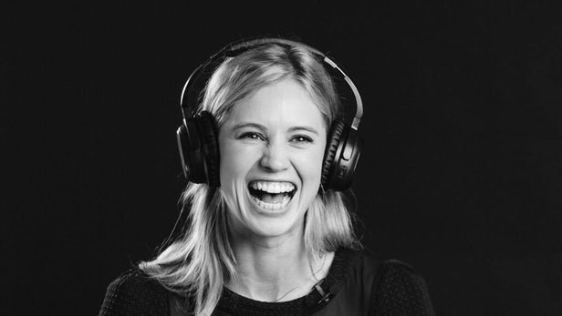
About Audeara

Slide 3


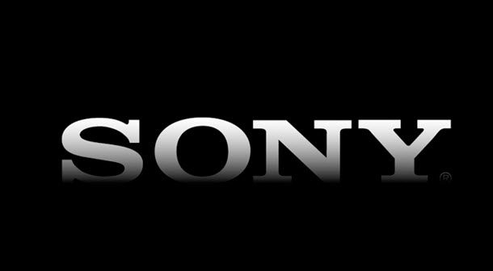
The Problem
Looking to focus on gaining a larger market share by attracting millenials more specifically, university students
Very competitive industry: competitors including Bose, Sony, and Beats
Audeara’s source of competitive advantage is their medical perspective, but millennials may simply not care
Need to influence millennials to buy into the brand’s message and idea

Slide 4
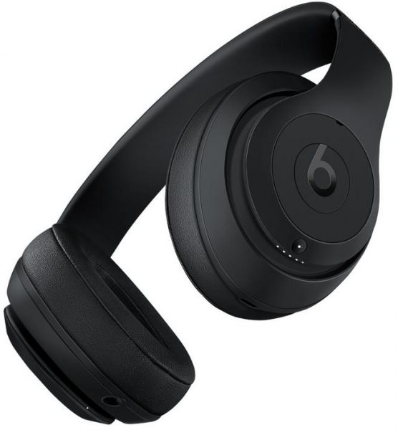
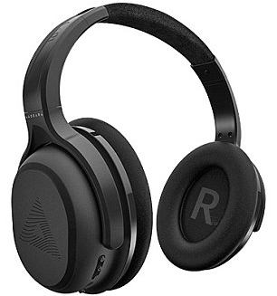
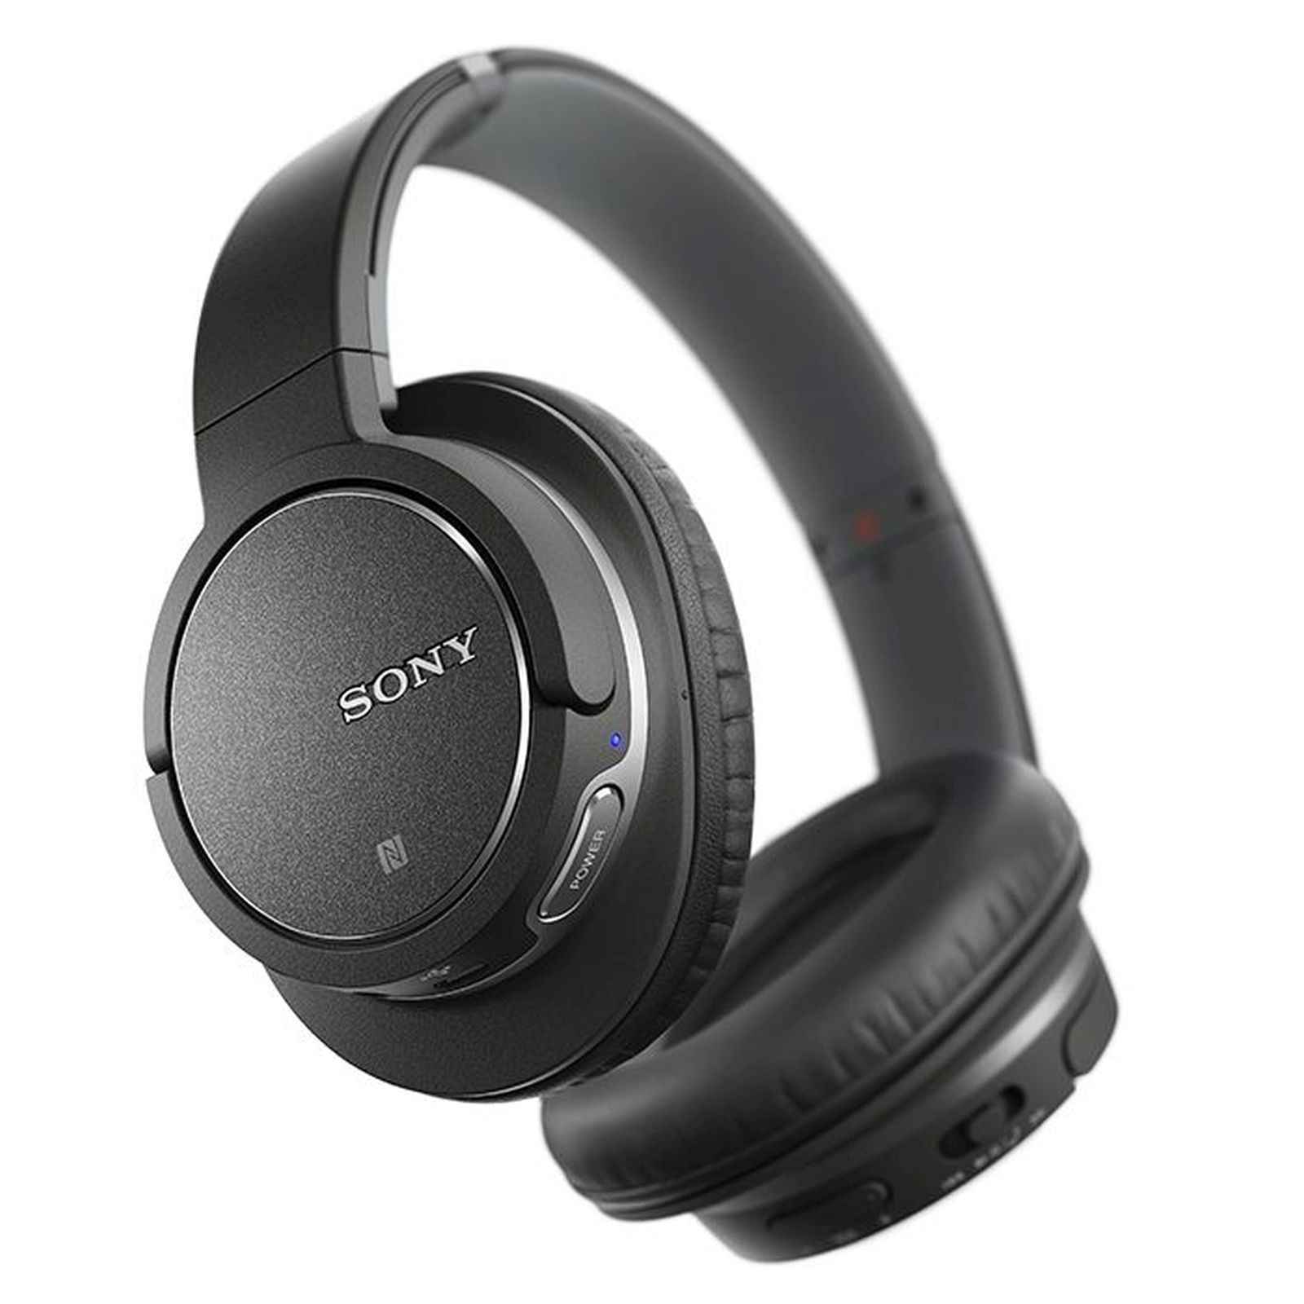
The Solution: Our Ideas
Three purchase motives:
Price:
We recommend a 10% student discount through My Unidays as well as the use of Afterpay
Assurance of benefits:
Setting up a testing booth for passersby to take the hearing test and notice the difference
Taking this to music festivals (e.g. Splendour in the Grass and BIGSOUND) and university open days
Appearance:
Currently quite generic
Possibility to offer numerous colours and textures

Slide 5
SWOT Analysis - Audeara
Strengths Designed by Doctors & engineers Tailored sound First in the market Innovative & highly sophisticated product | Weakness Lack of brand awareness and trust 15 minute test High price Product range narrow compared to competitors
Opportunity Lack of competitors Hearing impaired patients Design of product After pay Promotions | Threats Large competitors ie, Sony and Beats Rising manufacturing costs

Slide 6
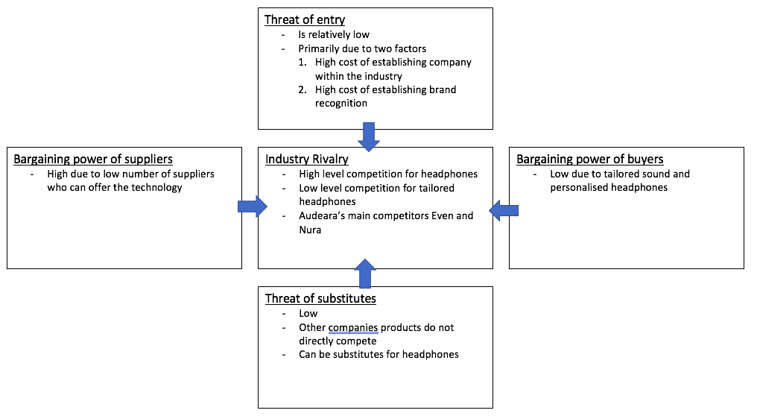
Porters Five Force Model

Slide 7
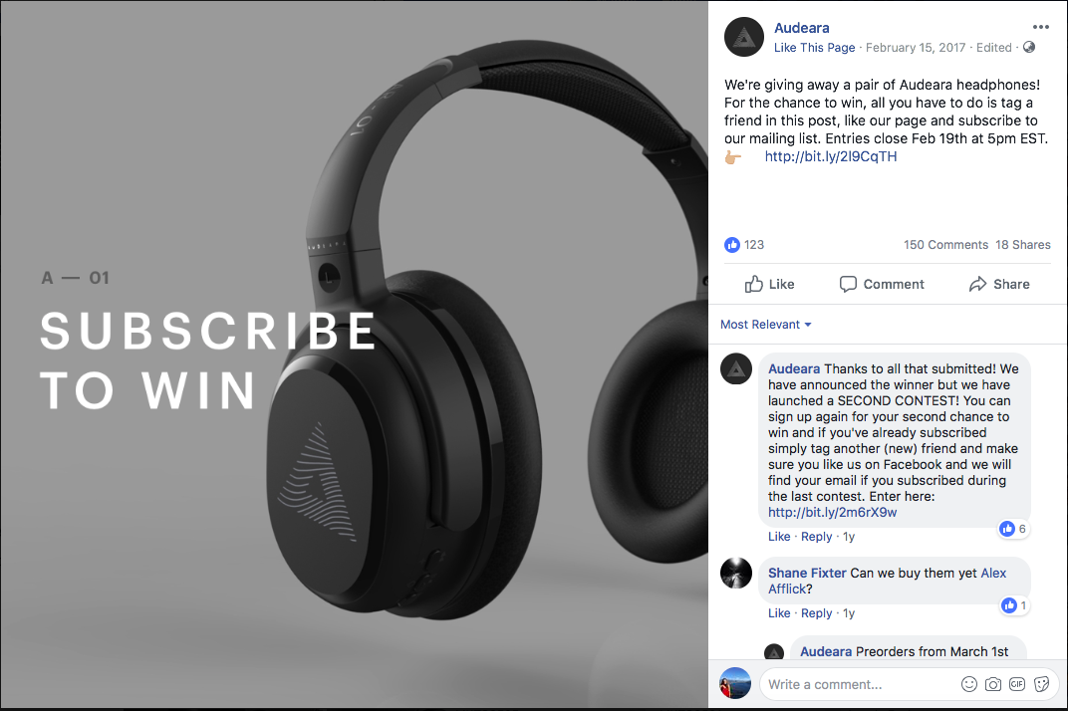
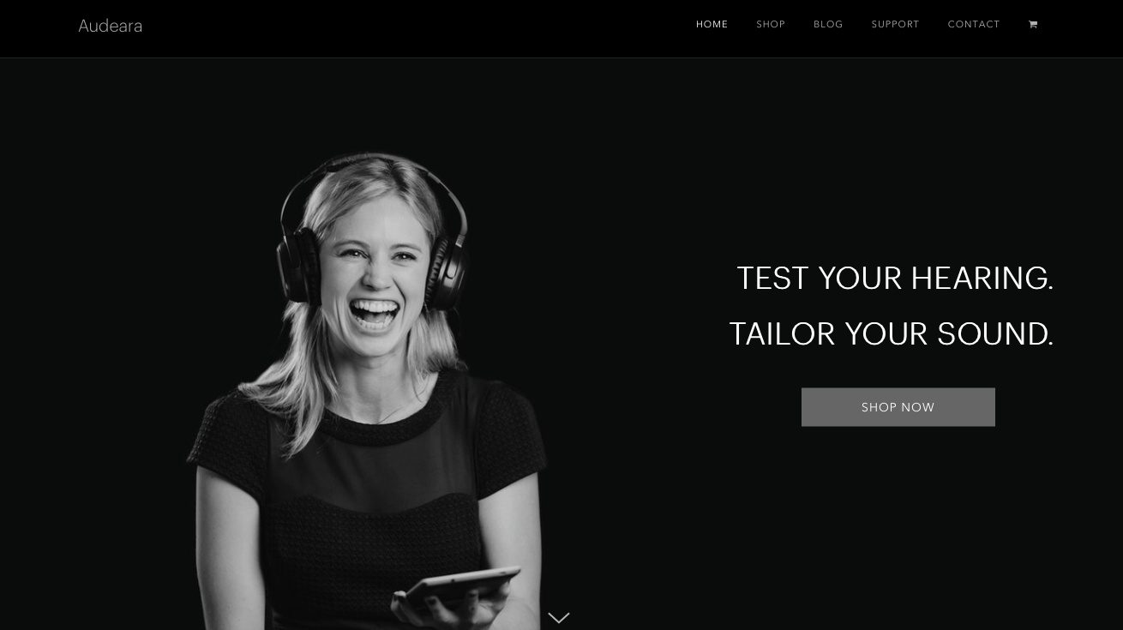
Marketing Materials

